Slide 1
Modern Systems Analysis and Design Eighth Edition, Global Edition Joseph S. Valacich Joey F. George
Chapter 1
The Systems Development Environment

Slide 2
Learning Objectives
Define information systems analysis and design.
Describe the information systems development life cycle (SDLC).
Explain computer-aided software engineering (CASE) tools.
Describe Agile Methodologies and eXtreme Programming.
Explain object-oriented analysis and design and the Rational Unified Process (RUP).

Slide 3
Introduction
Information Systems Analysis and Design
Complex organizational process
Used to develop and maintain computer-based information systems
Used by a team of business and systems professionals

Slide 4
Introduction (Cont.)
Application Software
Computer software designed to support organizational functions or processes
Systems Analyst
Organizational role most responsible for analysis and design of information systems
Notes:
Another category of software is systems software.

Slide 5
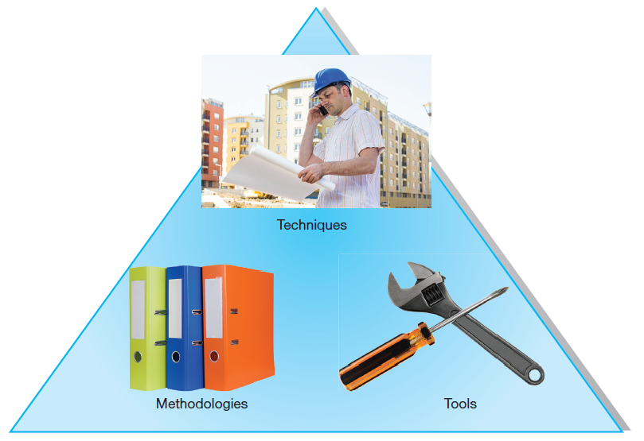
Introduction (Cont.)
FIGURE 1-1 An organizational approach to systems analysis and
design is driven by methodologies, techniques, and tools.
Sources: Mitarart/Fotolia, PaulPaladin/Fotolia
Notes:
As a systems analyst, you fill the organizational role most responsible for the analysis and design of information systems. To do this you’ll apply methodologies, techniques, and software tools.
Methodologies are comprehensive, multiple-step approaches to systems development that will guide your work and influence the quality of your final product—the information system.
Techniques are particular processes that you, as an analyst, will follow to help ensure that your work is well thought out, complete, and comprehensible to others on your project team.
Tools are typically computer programs that make it easy to use and benefit from techniques and to faithfully follow the guidelines of the overall development methodology.

Slide 6
A Modern Approach to Systems Analysis and Design
1950s: focus on efficient automation of existing processes
1960s: advent of procedural third generation languages (3GL) faster and more reliable computers
1970s: system development becomes more like an engineering discipline

Slide 7
A Modern Approach to Systems Analysis and Design (Cont.)
1980s: major breakthrough with 4GL, CASE tools, object-oriented methods
1990s: focus on system integration, GUI applications, client/server platforms, Internet
The new century: Web application development, wireless PDAs and smart phones, component-based applications, per-use cloud-based application services.

Slide 8
Developing Information Systems
System Development Methodology is a standard process followed in an organization to conduct all the steps necessary to analyze, design, implement, and maintain information systems.

Slide 9
Systems Development Life Cycle (SDLC)
Traditional methodology used to develop, maintain, and replace information systems
Phases in SDLC:
Planning
Analysis
Design
Implementation
Maintenance
Notes:
The SDLC is a particular form of business problem-solving cycles. A common feature of cycles is that they tend to loop and repeat. And each involves some sort of up-front planning and feasibility assessment, followed by more detailed and meticulous exploration and analysis of the problem, which typically result in some set of solution alternatives from which to pick and implement. After that, there should be continuous monitoring and adjustment, which often leads to earlier steps, thus making it a cycle.

Slide 10
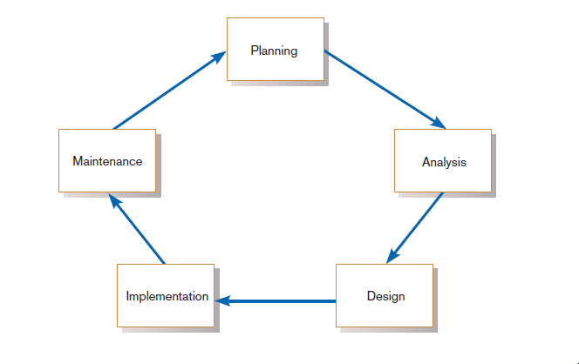
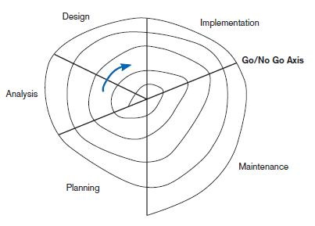
Standard and Evolutionary Views of SDLC
FIGURE 1-3 Evolutionary model
FIGURE 1-2
Systems development life cycle
Notes:
The traditional SDLC is very detailed and meticulous, and originally came about in the early years of IT when legacy mainframe systems were the norm, and requirements had to be very well known in order to code the final solution. But as more tools and techniques came along, this enabled a more organic, evolutionary approach. In the following slides we’ll look at some of these differences.
Some people consider the life cycle to be a spiral, in which we constantly cycle through the phases at different levels of detail, and figure 1.3 illustrates this idea.

Slide 11
Systems Development Life Cycle (SDLC) (Cont.)
Planning – an organization’s total information system needs are identified, analyzed, prioritized, and arranged
Analysis – system requirements are studied and structured
Design – a description of the recommended solution is converted into logical and then physical system specifications

Slide 12
Systems Development Life Cycle (SDLC) (Cont.)
Logical design – all functional features of the system chosen for development in analysis are described independently of any computer platform
Physical design – the logical specifications of the system from logical design are transformed into the technology-specific details from which all programming and system construction can be accomplished

Slide 13
Systems Development Life Cycle (SDLC) (Cont.)
Implementation – the information system is coded, tested, installed and supported in the organization
Maintenance – an information system is systematically repaired and improved

Slide 14
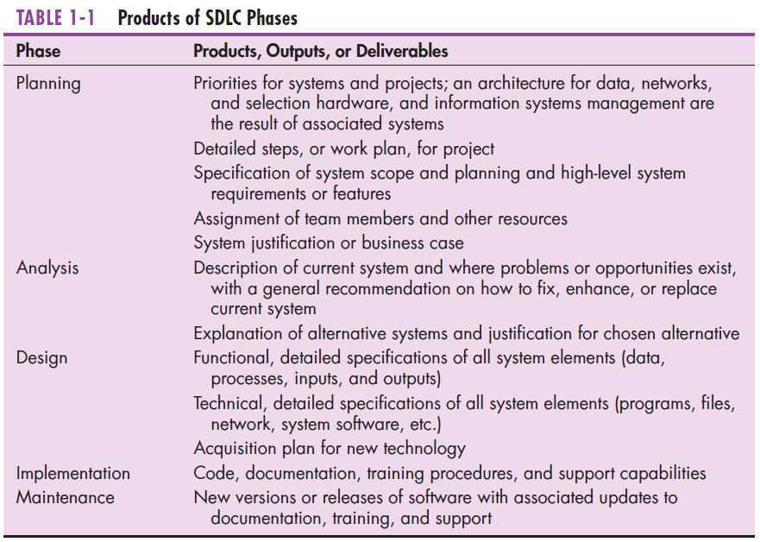
Notes:
The products of each phase become inputs and resources for the next phase.
Shortly we’ll see that this traditional SDLC follows a “waterfall” approach, where one phase “flows” into the next.

Slide 15
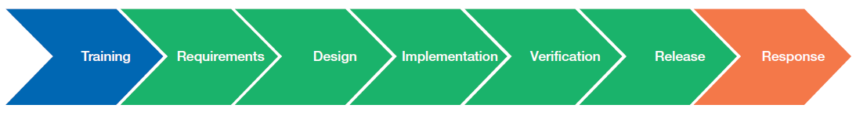
A Specialized Systems Development Life Cycle
Figure 1-7
Microsoft’s Security Development Lifecycle (SDL)
Training focuses on security.
Verification focuses on product quality assurance.
Release makes product available for general use.
Response deals with security problems that come up after product release.
These are like traditional SDLC’s analysis, design, and implementation.
(Source: http://www.microsoft.com/security/sdl/default.aspx.
Used by permission.)
Notes:
Note that different companies may have their own special SDLC methodologies for certain types of information systems problems. For example, Microsoft has a method they call “security development lifecycle (SDL)” which includes these steps: training, requirements, design, implementation, verification, release, response. Although these are not exactly identical to SDLC, there is a lot of overlap. In this case, the cycle is for ensuring security in the software products Microsoft develops. In particular, the verification and release stages reflect Microsoft as a product vendor. By contrast, traditional SDLC (which include planning and maintenance) tends to apply to business or organizational applications. So, the sort of problem and the type of industry can affect your choice of SDLC methodology.

Slide 16
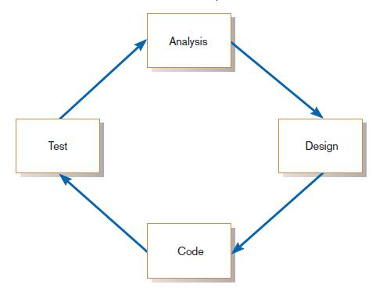
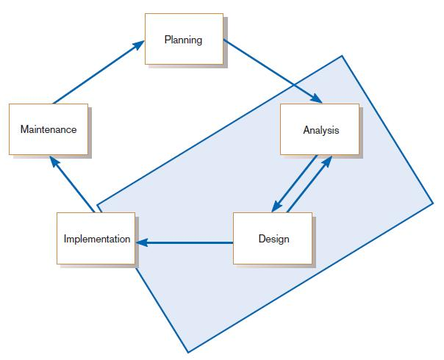
The Heart of the Systems Development Process
FIGURE 1-8
Analysis–design–code–test loop
Current practice combines analysis, design, and implementation into a single iterative and parallel process of activities.
Notes:
We’re going to talk about eXtreme programming and Agile methodologies shortly. This is the current approach to software development. In a sense you can think of replacing one big SDLC cycle in which extensive time spend in analysis and design before programming. Instead, you have with newer approaches lots of short-term cycles involving some analysis, design, and coding, followed by another stage of analysis, design, and coding, etc. As I mentioned earlier, this is a much more evolutionary and free-flow process. And it’s possible because of the great advance in modeling, design and CASE tools, as well as software framework APIs.

Slide 17
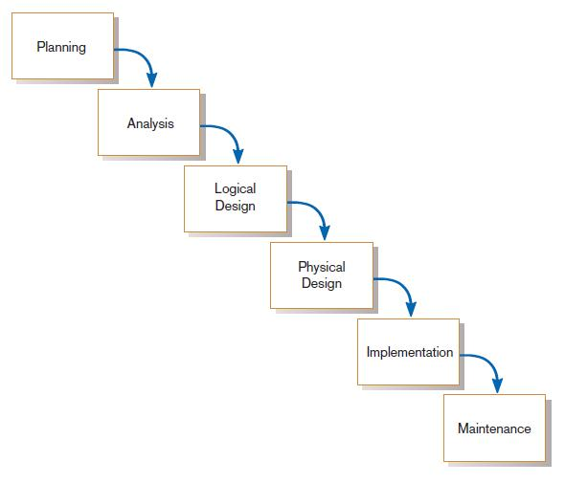
Traditional Waterfall SDLC
One phase begins when another completes, with little backtracking and looping.
FIGURE 1-10
Traditional waterfall SDLC
Notes:
Here again we see the more traditional SDLC. As a waterfall, you don’t see cycling back. An earlier picture shows SDLC as a cycle, but although it’s a cycle, the idea is to avoid cycling back unless we encounter some problem at a particular stage. For example, if in the design phase we see that we can’t go forward without more analysis, we may go back to analysis. But the hope is to keep surging forward.

Slide 18
Problems with Waterfall Approach
Feedback ignored, milestones lock in design specs even when conditions change
Limited user involvement (only in requirements phase)
Too much focus on milestone deadlines of SDLC phases to the detriment of sound development practices
Notes:
As you can see, this has its disadvantages. In general, the traditional SDLC approach is not very flexible and adaptive. It was the only plausible approach back in the days of legacy systems. But now it’s an outdated methodology. Nevertheless, it has evolved and mutated to other more timely approaches, which we’ll be discussing next.

Slide 19
Different Approaches to Improving Development
CASE Tools
Agile Methodologies
eXtreme Programming
Notes:
Remember when we talked about the use of tools, methodologies, and techniques? These are three of these. We’ll discuss each in turn.

Slide 20
Computer-Aided Software Engineering (CASE) Tools
Diagramming tools enable graphical representation.
Computer displays and report generators help prototype how systems “look and feel”.
Notes:
IBM’s Rational products are a popular example of CASE tools.

Slide 21
Computer-Aided Software Engineering (CASE) Tools (Cont.)
Analysis tools automatically check for consistency in diagrams, forms, and reports.
A central repository provides integrated storage of diagrams, reports, and project management specifications.

Slide 22
Computer-Aided Software Engineering (CASE) Tools (Cont.)
Documentation generators standardize technical and user documentation.
Code generators enable automatic generation of programs and database code directly from design documents, diagrams, forms, and reports.

Slide 23
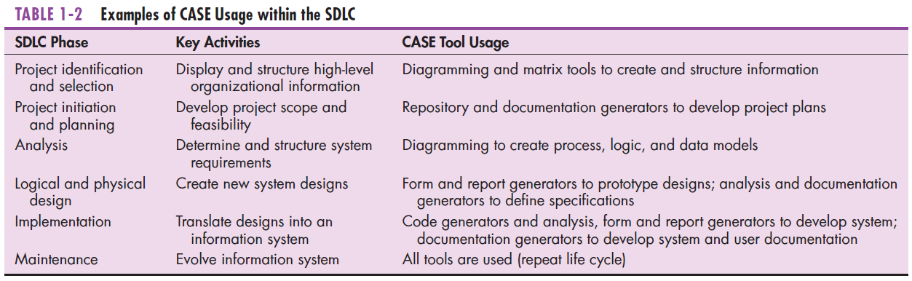
CASE Tools (Cont.)
Notes:
As you can see, CASE tools are used throughout the SDLC process.
CASE helps programmers and analysts do their jobs more efficiently and more effectively by automating routine tasks. However, many organizations that use CASE tools don’t use them to support all phases of the SDLC. For example, some organizations may extensively use the diagramming features but not the code generators.

Slide 24
Agile Methodologies
Motivated by recognition of software development as fluid, unpredictable, and dynamic
Three key principles
Adaptive rather than predictive
Emphasize people rather than roles
Self-adaptive processes
Notes:
Another buzzword with a similar idea is “Rapid Application Development (RAD)”. This phrase has gone out of favor, and “Agile” is more in vogue. Also coming into vogue is SCRUM.
These ideas are variations on a theme of bringing adaptive techniques into the SDLC methodology. A very early “adaptive SDLC” approach in that vein was called “prototyping”.

Slide 25
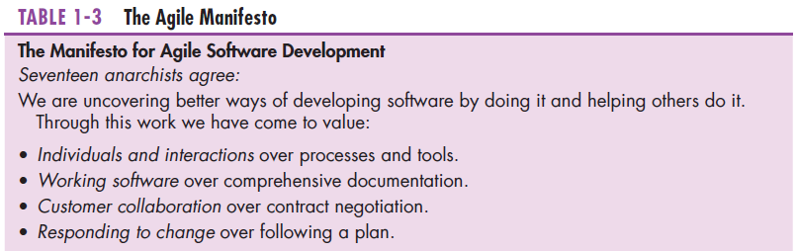
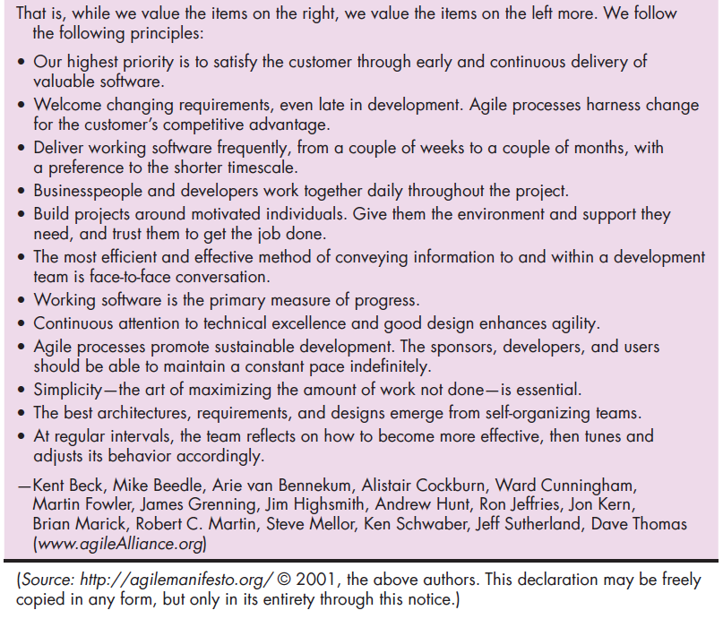
The Agile Methodologies group argues that software development methodologies
adapted from engineering generally do not fit with real-world software development.
Notes:
The agile approach emphasizes people as individuals over their roles. In a way it humanizes software development and allows for change over time, whereas the traditional SDLC is more formal and structured.

Slide 26
When to use Agile Methodologies
If your project involves:
Unpredictable or dynamic requirements
Responsible and motivated developers
Customers who understand the process and will get involved

Slide 27
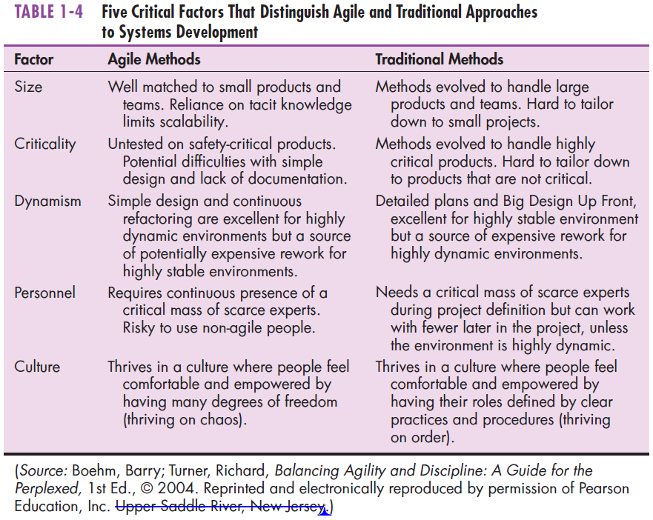

Notes:
Again, you see the distinction between the agile and traditional approaches. The agile approach comes with its risks, as you can see with the statement regarding criticality. The traditional SDLC is better suited to large enterprise-wide projects whereas agile methods are better for ad hoc needs and smaller projects. It fosters creativity, but also requires people who are comfortable thinking outside the box, as you can see in the statement regarding culture.
Most companies use both methods, focusing more on agile in some projects and more on traditional SDLC in others.

Slide 28
eXtreme Programming
Short, incremental development cycles
Automated tests
Two-person programming teams
Coding, testing, listening, designing
Notes:
eXtreme Programming was developed by Kent Beck., who co-wrote this book referenced by our textbook:
Beck, K., and C. Andres. 2004. eXtreme Programming eXplained.
Upper Saddle River, NJ: Addison-Wesley.
Note the emphasis on small two-person teams. Also note the short development cycles. So this is definitely an example of an agile methodology.

Slide 29
eXtreme Programming (Cont.)
Coding and testing operate together
Advantages:
Communication between developers
High level of productivity
High-quality code
Notes:
In traditional SDLC on large scale systems, coders and testers are often two different and specialized roles. Here there is a code/test/code/test cycle that both members of the team iterate through,
In the old days (when traditional SDLC was developed), testing a program was a much more laborious process than it is now with modern IDEs (integrated development environments). Now there are many sophisticated debugging and testing tools that make the code/test/code/test cycle easy.
The emphasis on high-quality code has some implications here, Whereas a first-draft code may result in something that works, the code may not be flexible or elegant, and could contain extraneous code. Part of the programming effort involves continuously improving the code.

Slide 30
Object-Oriented Analysis and Design (OOAD)
Based on objects rather than data or processes
Object: a structure encapsulating attributes and behaviors of a real-world entity
Notes:
Object orientation is currently the most common software development paradigm. The previous paradigm can be described as “task decomposition”. With this approach, you have an overall program and divide it into tasks, which can further be decomposed into subtasks, etc. In this approach modularity is achieved by creating functions or subroutines to do commonly-performed tasks.
With object-orientation you have a different perspective. Here you have classes (or categories) of objects that each contain a certain state (the contents of its data) and perform certain behaviors (often called “methods”). This approach enables creation of “components” that can be grouped together in various ways to accomplish a variety of problems. Object-orientation fosters code-reusability and it also leads to more flexible software libraries. In this sense, object-orientation is very conducive with agile methodologies.

Slide 31
Object-Oriented Analysis and Design (OOAD) (Cont.)
Object class: a logical grouping of objects sharing the same attributes and behaviors
Inheritance: hierarchical arrangement of classes enable subclasses to inherit properties of superclasses
Notes:
The notion of inheritance is important in OOAD. Classes can inherit properties and behaviors from superclasses, and then add specialized behaviors of their own. Conceptually, an object of a certain class is also a member of its superclass. For example, a dog is a mammal which is an animal. Therefore a dog is also an animal. Animal is a superclass of mammal which is a superclass of dog.

Slide 32
Rational Unified Process (RUP)
An object-oriented systems development methodology
Establishes four phase of development: inception, elaboration, construction, and transition
Each phase is organized into a number of separate iterations.
Notes:
RUP is a popular approach to object-oriented system development. A development project is broken into phases, each of which go through a set of iterations.

Slide 33
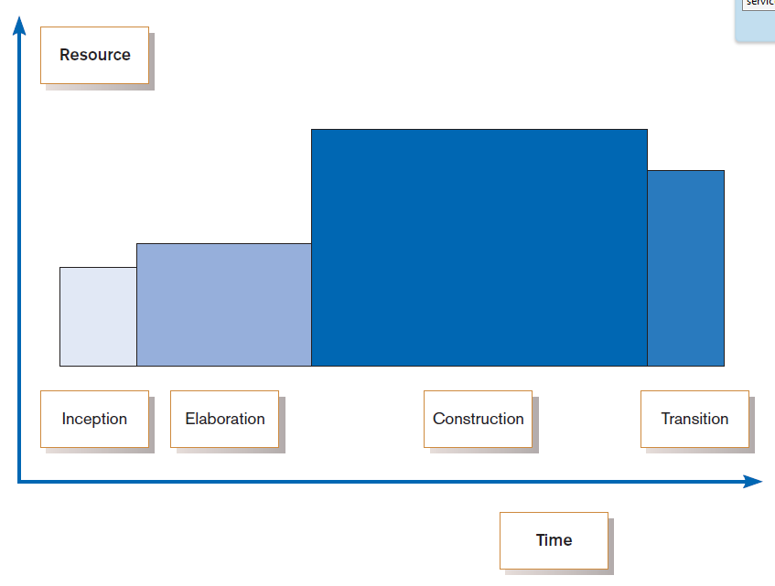
FIGURE 1-11
Phases of OOSAD-based development
Notes:
This graph shows the four phases: inception, elaboration, construction, and transition. As you can see, the most time-consuming and resource-intensive phase is construction. Inception is a lot like planning in the traditional SDLC. Elaboration in RUP is like a combination of SDLC’s analysis and design. Construction has elements of physical design and implementation. And transition is a lot like maintenance.
So the various tasks of SDLC are also being done in RUP, but with different emphases and sequences.

Slide 34
Our Approach to Systems Development
Criticisms of SDLC
Forcing timed phases on intangible processes (analysis and design) is doomed to fail
Too much formal process and documentation slows things down
Cycles are not necessarily waterfalls
And yet the concept of a cycle is in all methodologies. So, SDLC is a valuable model that has many variations.

Slide 35
Summary
In this chapter you learned how to:
Define information systems analysis and design.
Describe the information systems development life cycle (SDLC).
Explain computer-aided software engineering (CASE) tools.
Describe Agile Methodologies and eXtreme Programming.
Explain object-oriented analysis and design and the Rational Unified Process (RUP).

